Slide 1



Slide 2
OF Portal
Purpose – User-friendly complement to Jeeves targeted to management and infrequent users.
Web (crossbrowser) or Smartphones (selected areas)
Time / expense reporting and project management
Approval processes
Analyses
CRM
Reconciliation

Slide 3
OF Portal modules part 1
Accounts Payable
  Invoice Approval (Jeeves e-approval)
  Payment services
  Retrieval of invoices
Reporting (SQL Reporting Services based)
  150 public reports and 100 Customer reports.
  Scheduled e-mail and file distribution
Project management
  Time reporting
  Approval processes
  Project administration and analysis
  Case management
CRM
  Company & Persons
  Business opportunities
  Campaigns

Slide 4
OF Portal modules part 2
Financial analyses
  Drill-down to invoices
Reconciliation module
  Balance-account reconciliation
  Bank-reconciliation. Import of bank-statement
Manual invoicing
AP and AR quick reporting
User administration
Under development
  Web-pivot analyses of sales and financial data

Slide 5
Technical overview
Stored procedures dedicated for OF portal
Webservice - Language-Integrated Query (LINQ)
Components
    Asp.Net 3.5
    Microsoft AJAX Control toolkit
    JQuery 1.5.2
    Telerik RadComboBox
    DeusEx JsonRepeater

Slide 6
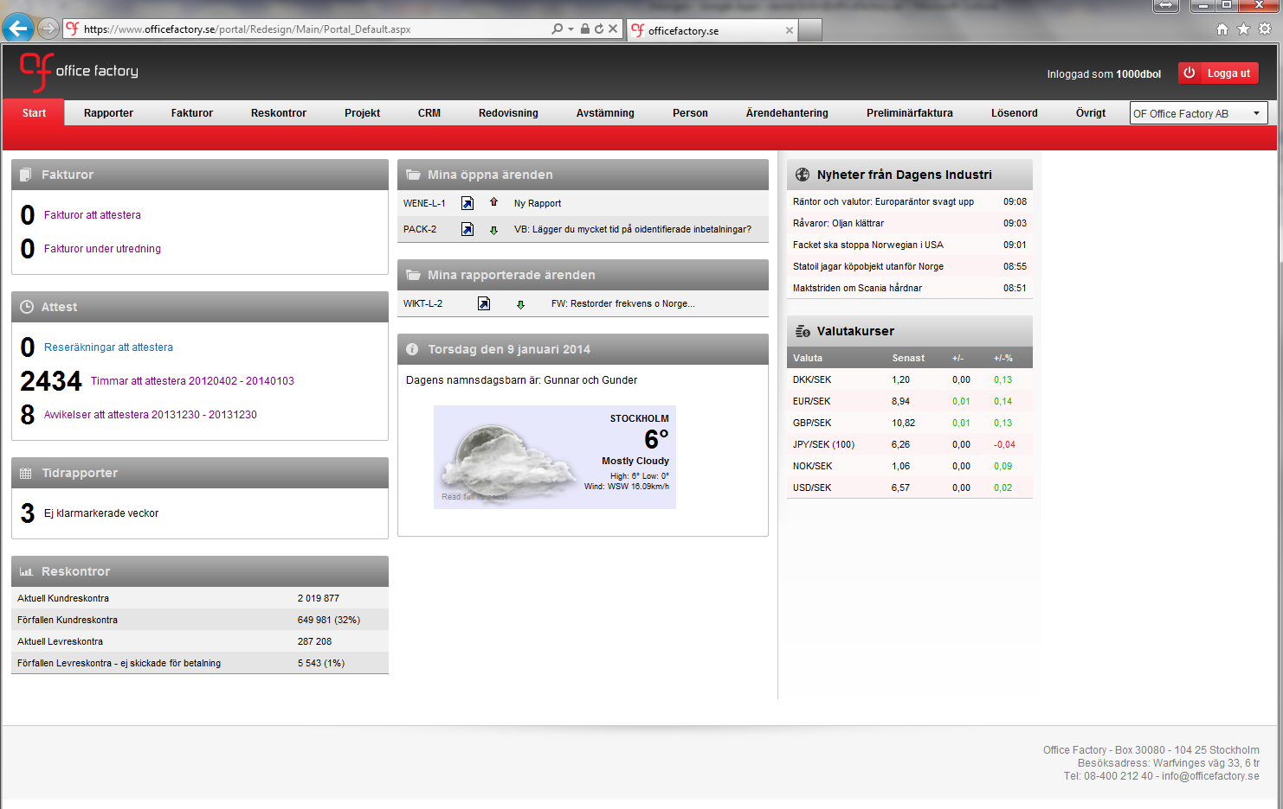
s
Startsida

Slide 7
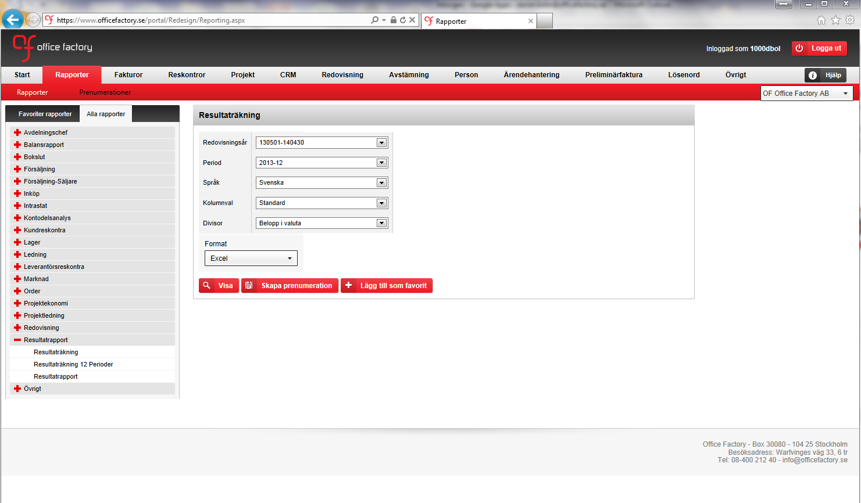
s
Rapporter

Slide 8
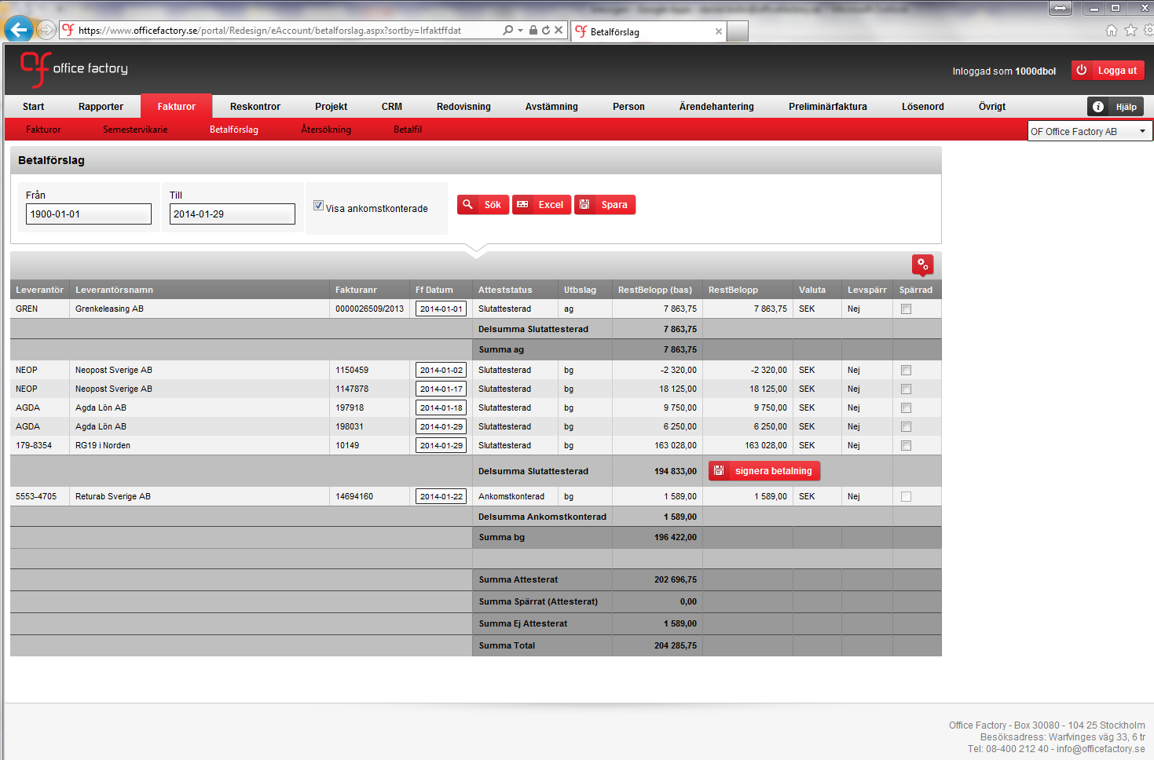
d
Skapa betalfiler

Slide 9
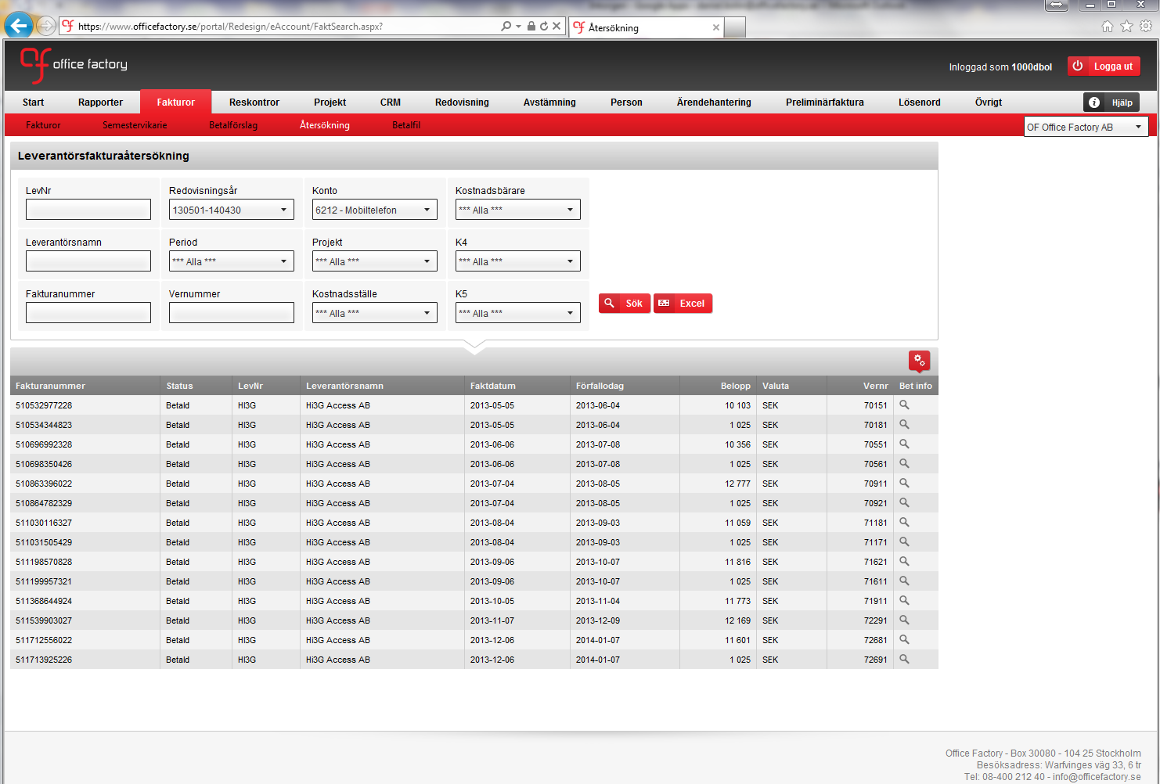
d
Återsökning av fakturor

Slide 10
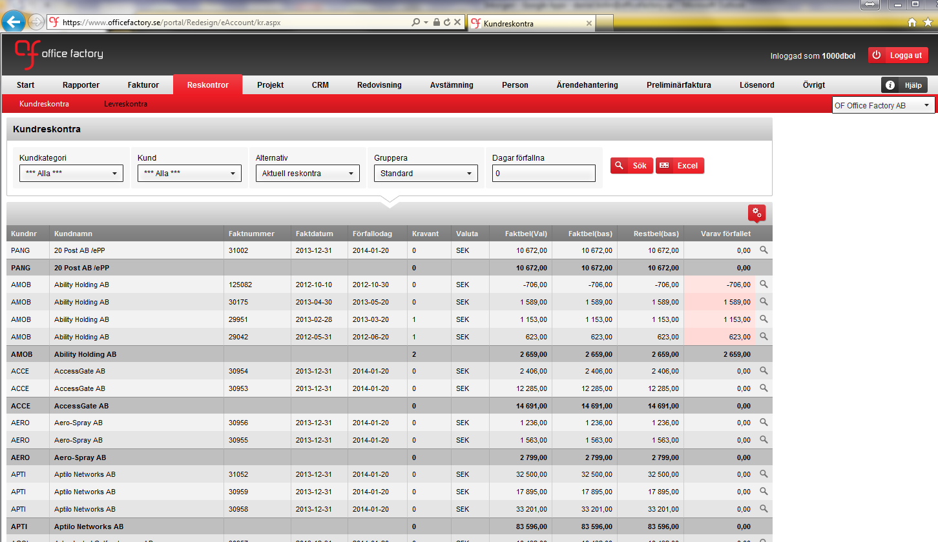
d
Kundreskontra

Slide 11
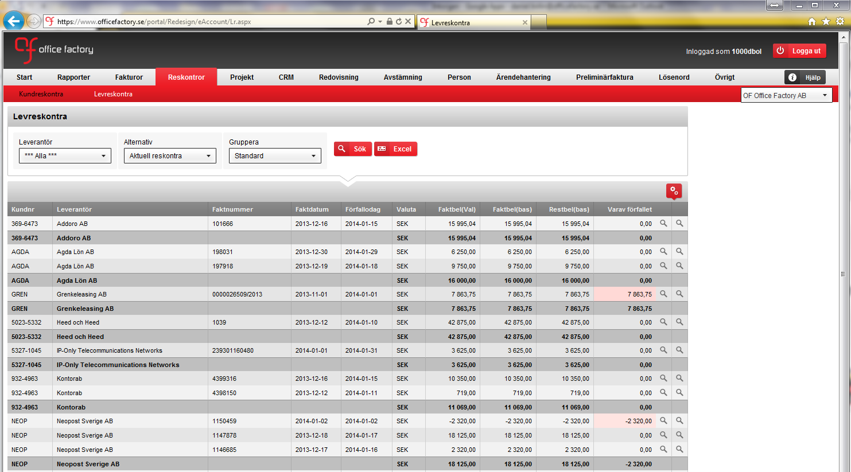
d
Leverantörsreskontra

Slide 12
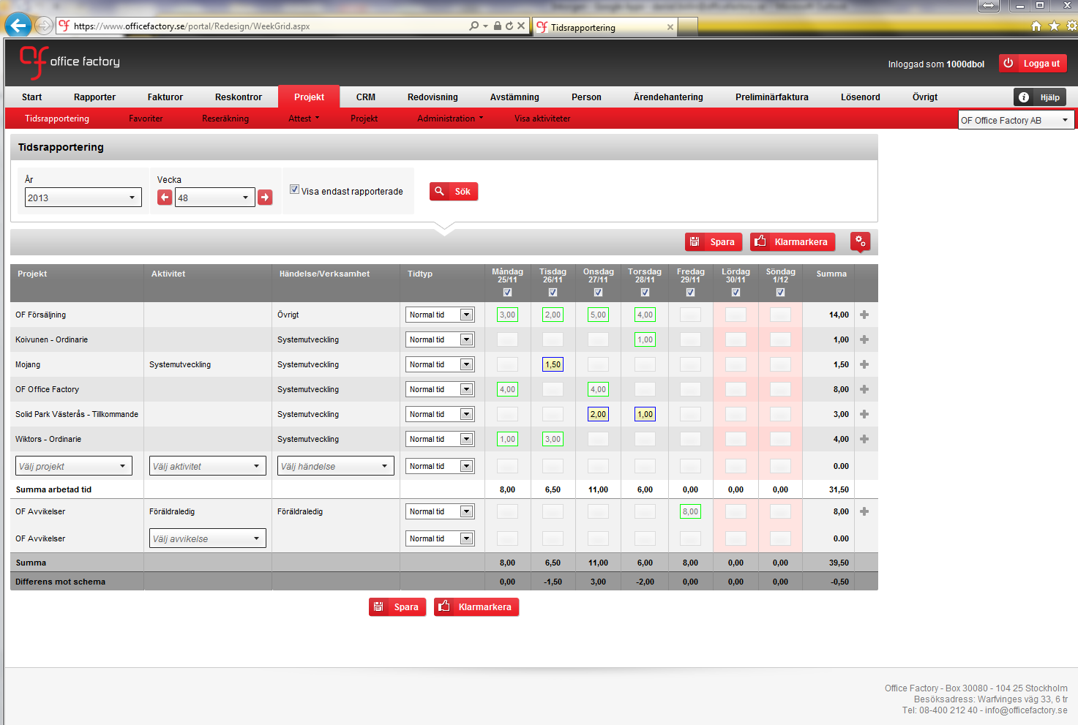
d
Projekt - tidsrapportering

Slide 13
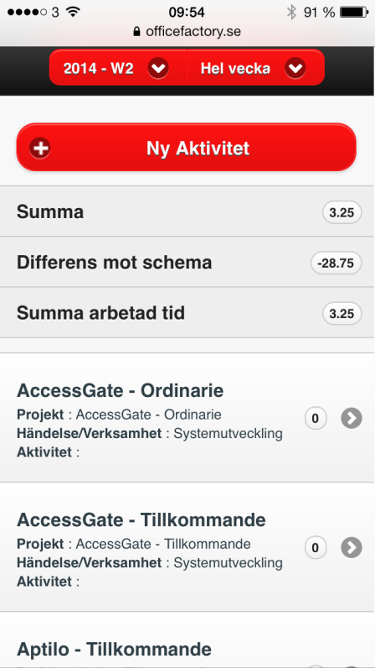
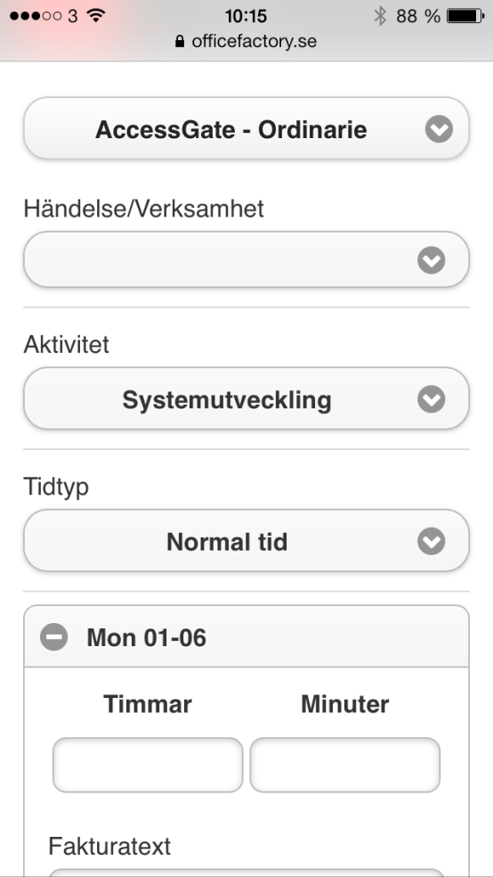
d
Mobil tidsrapportering

Slide 14
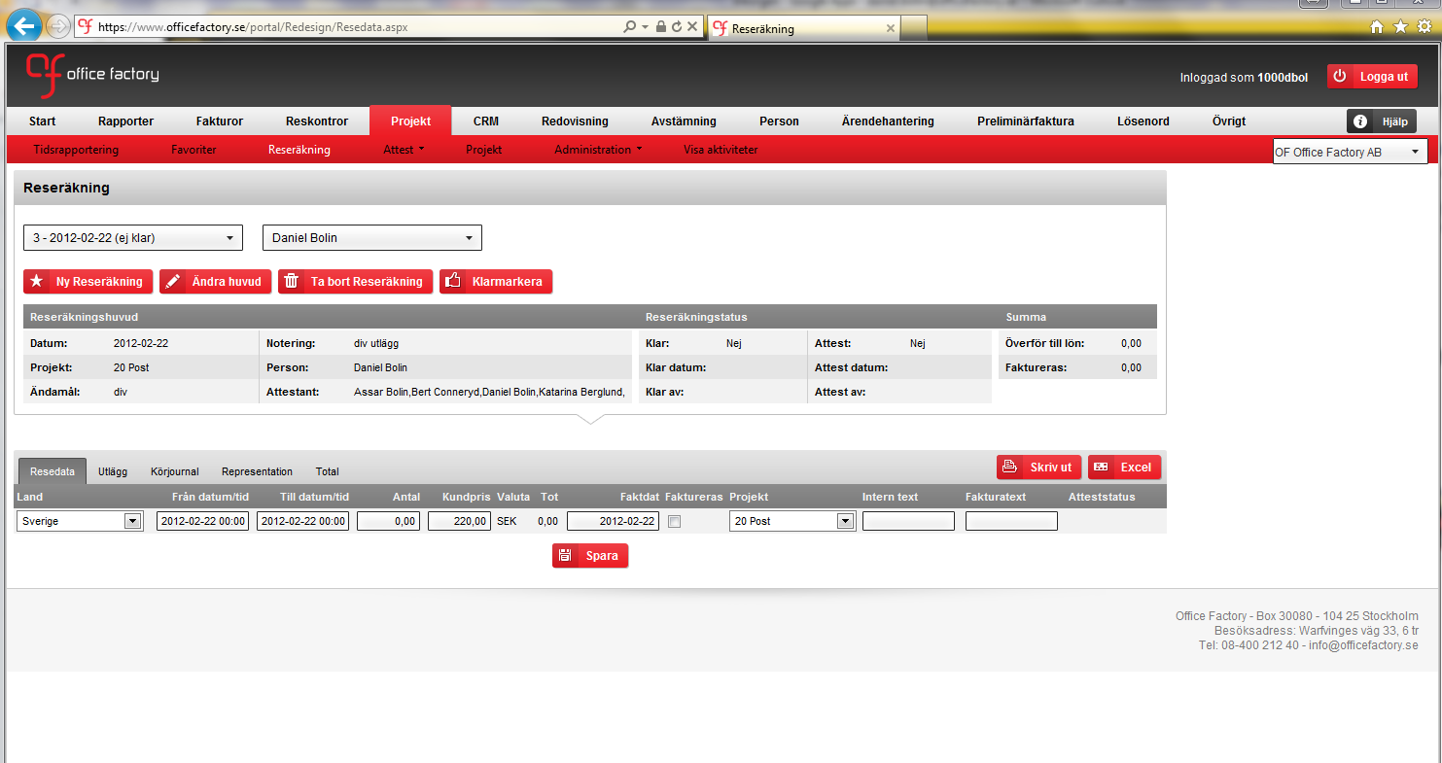
d
Reseräkningar

Slide 15
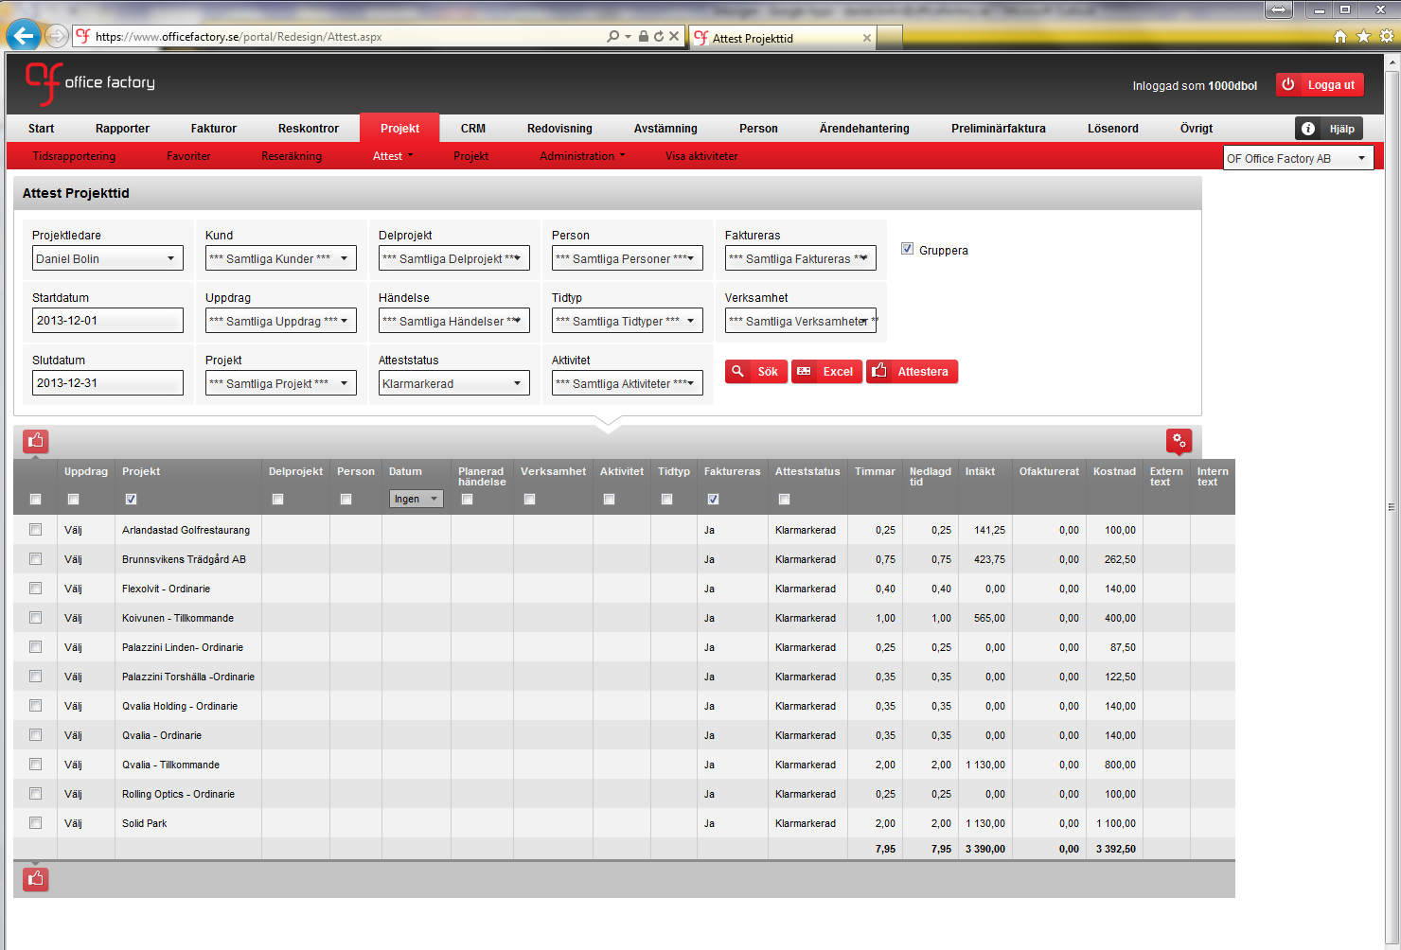
d
Projektledarattest

Slide 16
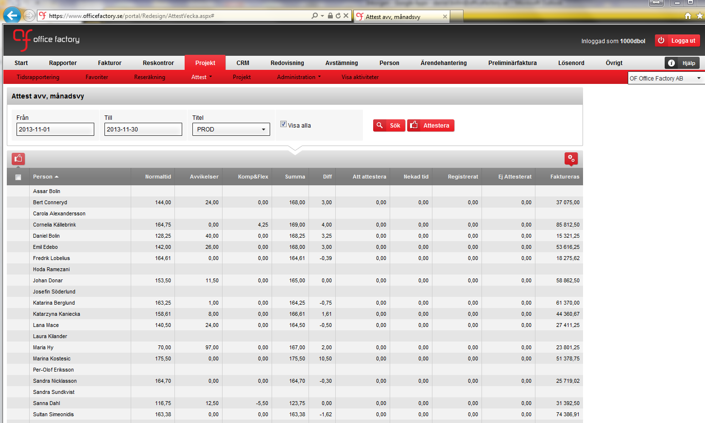
d
Linjechefsattest

Slide 17
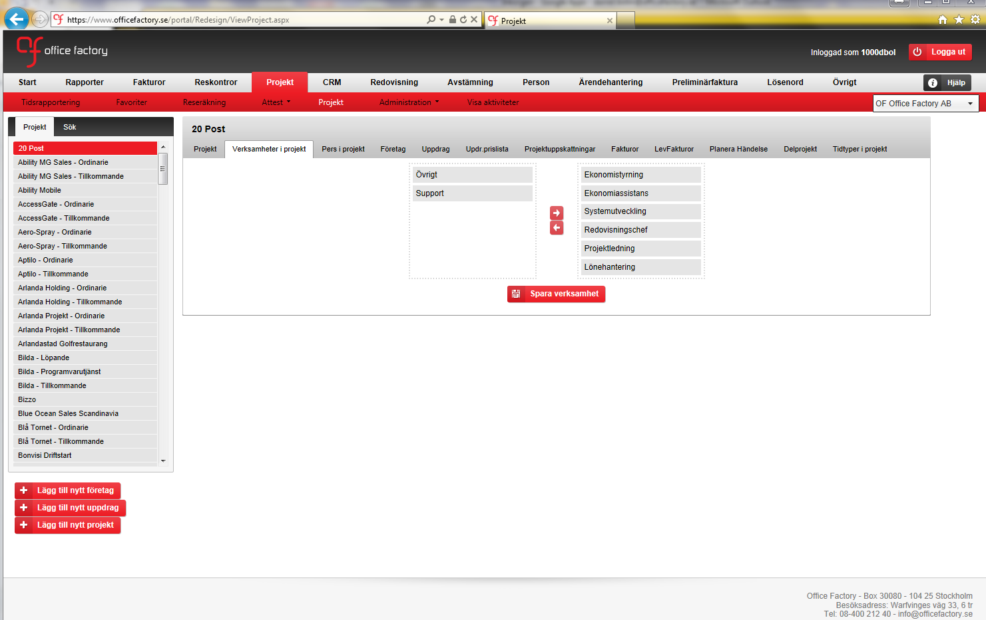
d
Administration av projekt

Slide 18
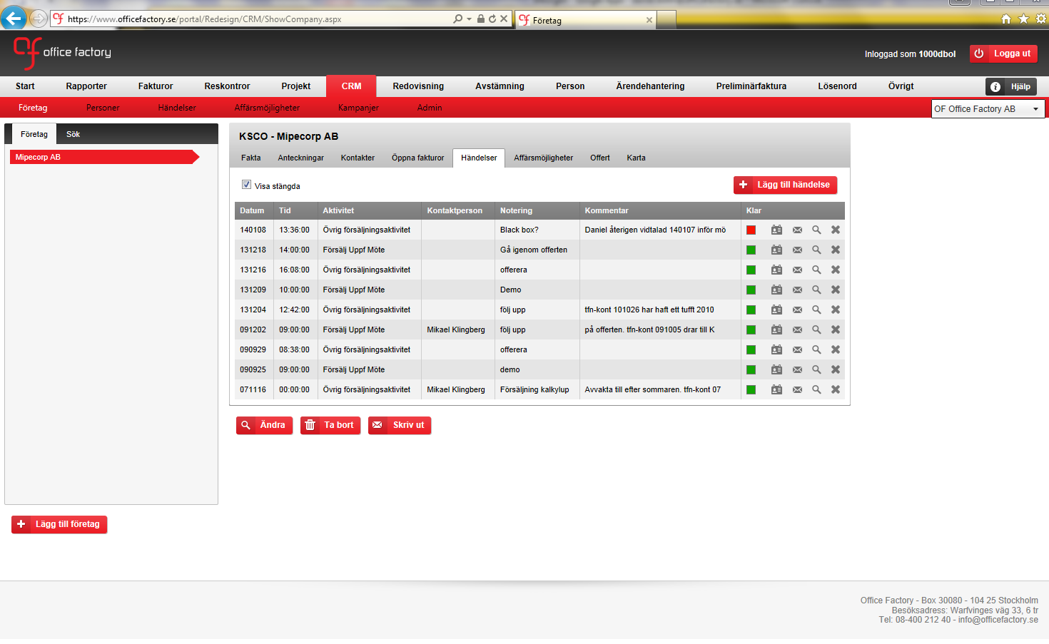
d
CRM

Slide 19
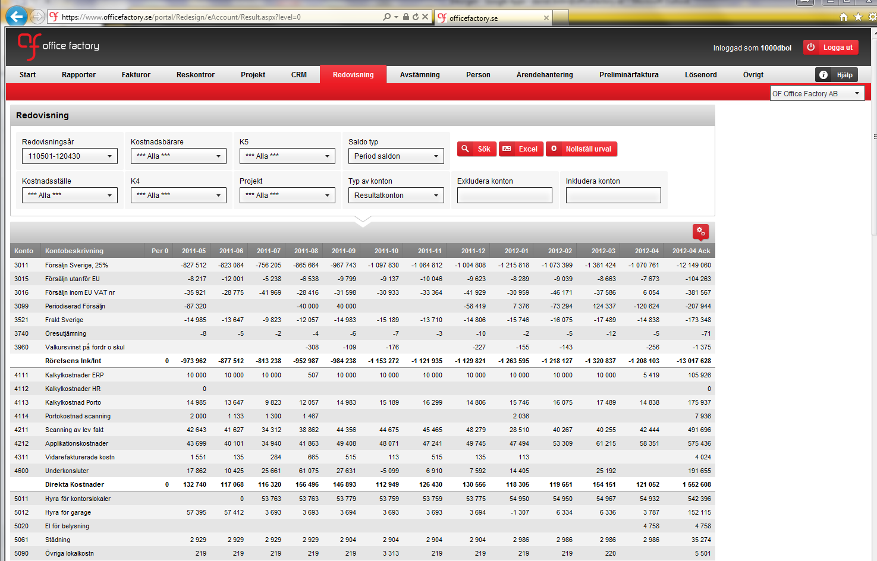
d
Redovisningsanalys

Slide 20
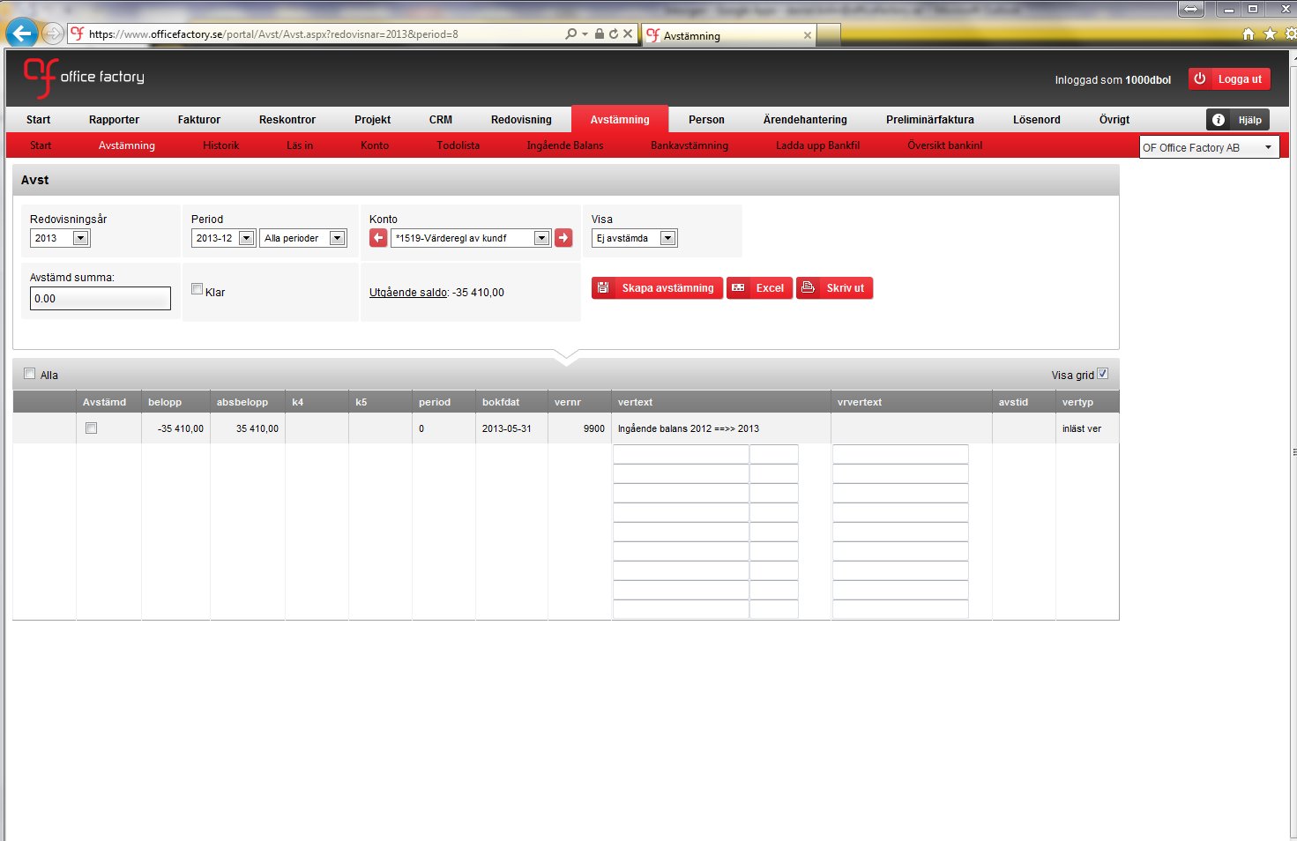
d
Avstämningsprogram

Slide 21
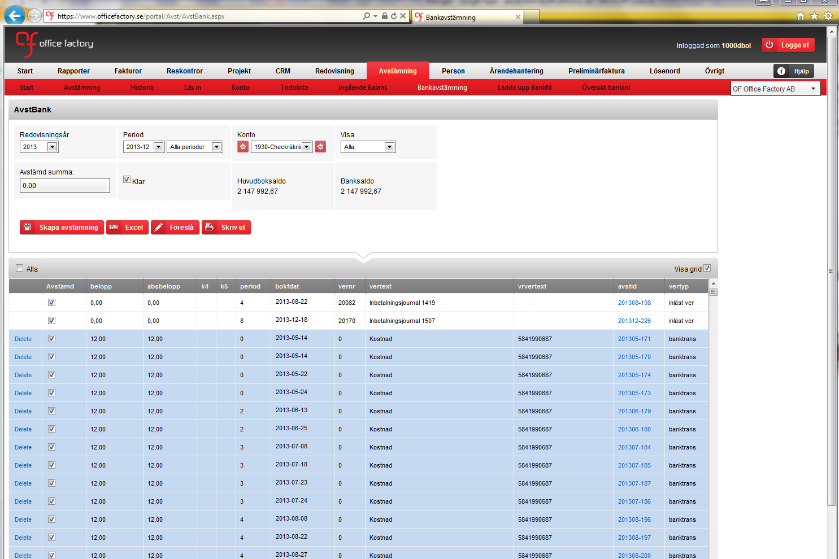
d
Bankavstämningsprogram

Slide 22
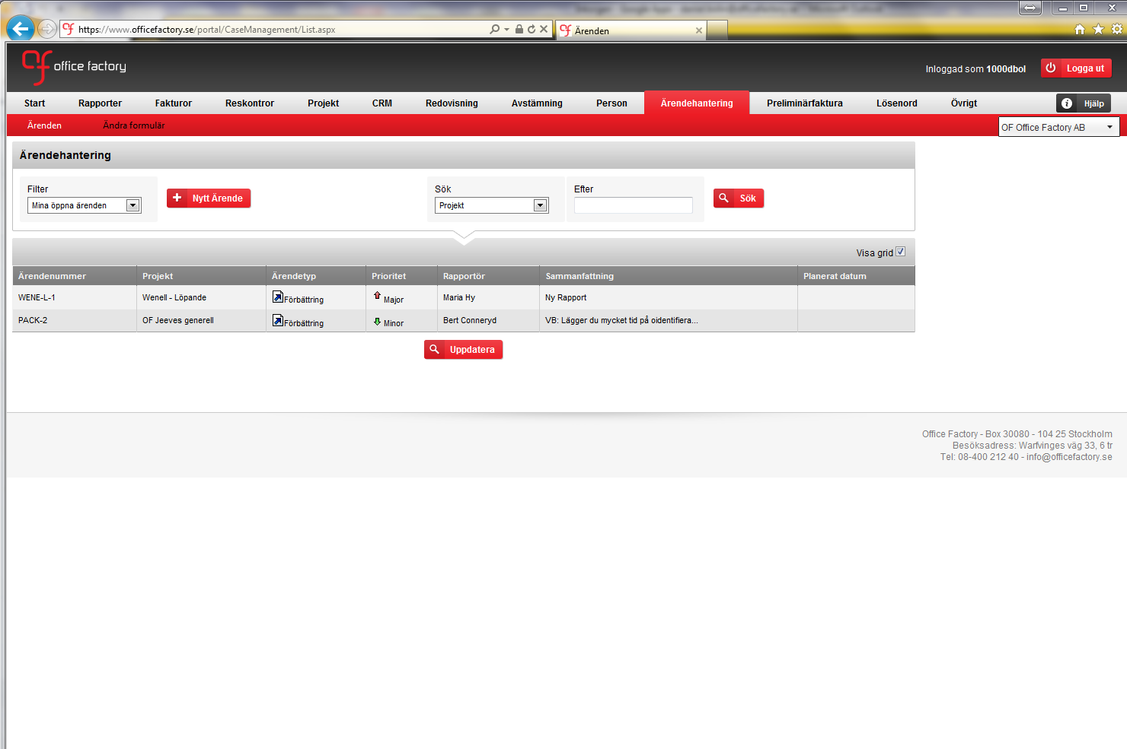
d
Ärendehantering

Slide 23
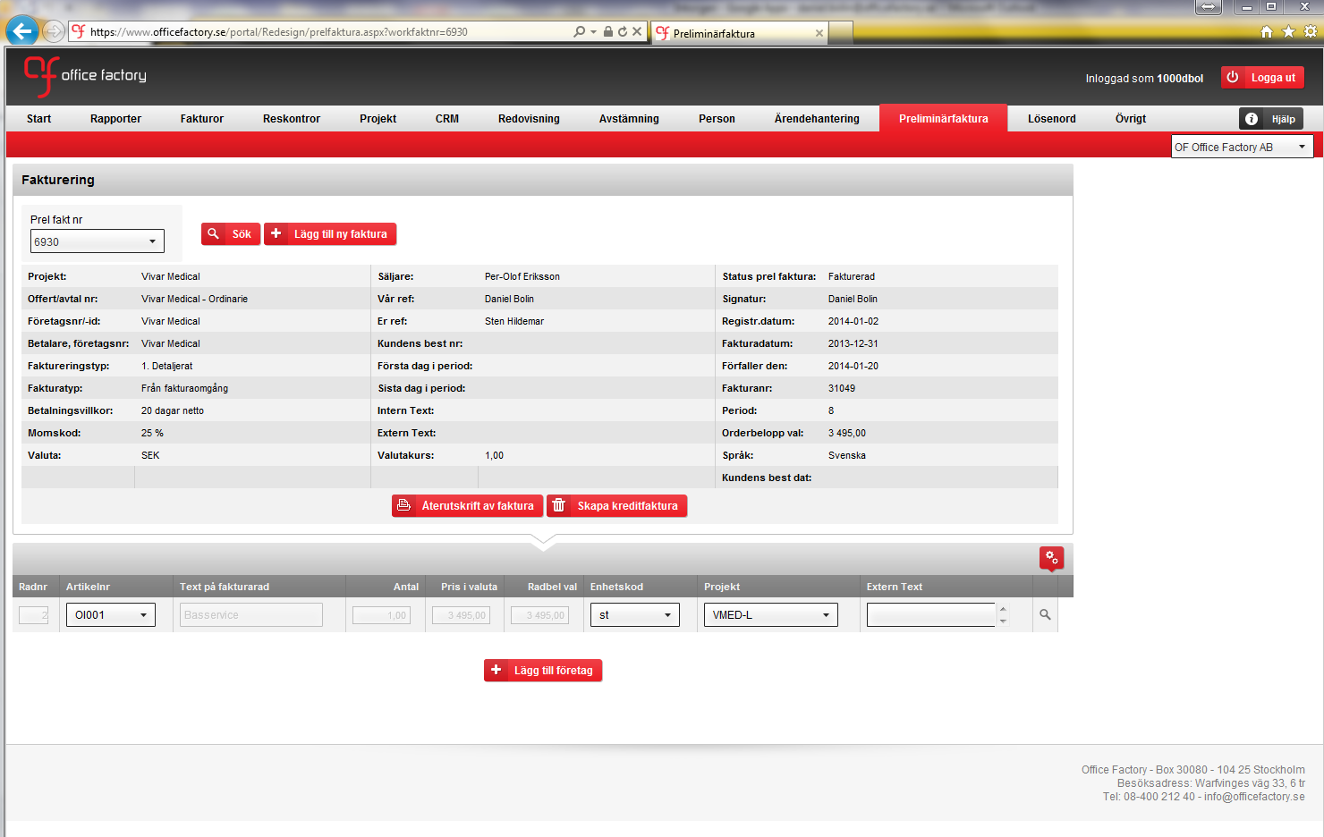
d
Manuell fakturering

Slide 24
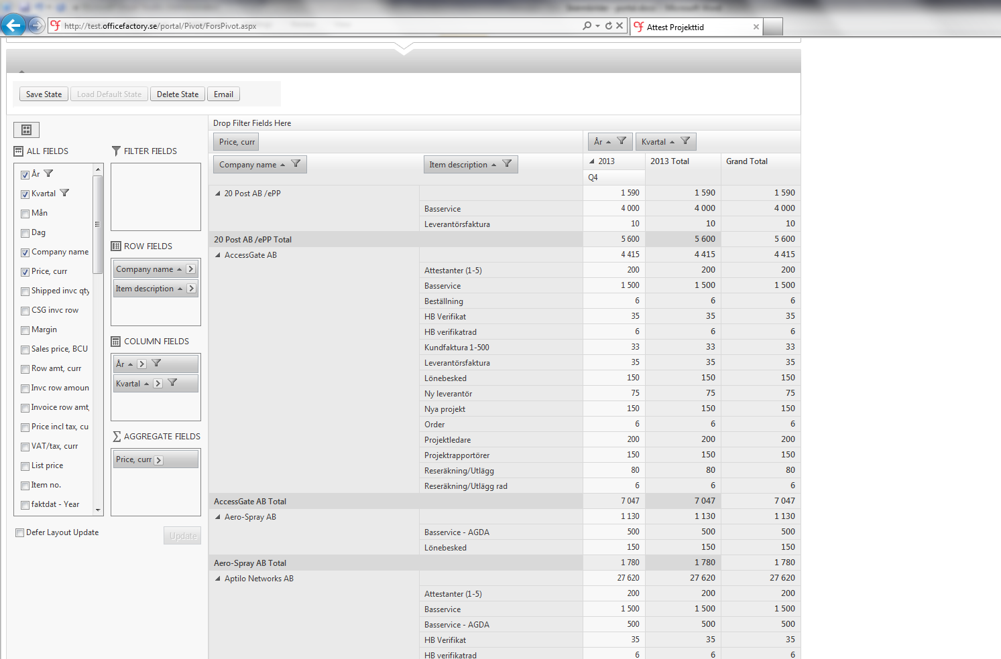
d
Webpivot

Slide 25
d
Skapa betalfiler

